Slide 1
Biomedical hyperspectral image segmentation
For brain tumor detection
Supervisor
Dr. Anuj Pradeep Deshpande
Chatla Raviteja – AP20110020003
A Gowtham – AP20110020011

Slide 2
Introduction:
Beyond the visible spectrum, hyperspectral imaging (HSI) is an advanced imaging method that records delicate spectral information at a broad range of wavelengths. In contrast with traditional imaging, Hyperspectral Imaging(HSI) offers a three-dimensional dataset with extensive spectral data contained in every pixel, enabling accurate material identification and improved brightness. High resolution, harmless , scalability to a wide range of applications (medical imaging, agricultural, environmental monitoring), and real-time imaging capabilities, which are essential for surgical guidance, are some of its advantages. Due to advances in technology and improved processing power, HSI is increasing popularity because of its capacity to offer in-depth, data-driven insights. HSI is a useful instrument in current medical science that improves patient care and outcomes due to its cost-effectiveness, which decreases the need for numerous imaging modalities and increases workflow efficiency.

Slide 3
Problem Statement :
Brain cancer detection and delineation during neurosurgical operations present significant challenges due to the difficulty in accurately identifying tumor boundaries and distinguishing between tumor and normal brain tissue. Current intraoperative imaging techniques, such as MRI and ultrasound, have limitations in providing real-time, high-resolution visualization of tumor margins without invasive procedures or significant cost

Slide 4
Literature Survey:
S.no | Reference paper | Paper Link | Proposed method
1. | Leon, R., Fabelo, H., Ortega, S., Cruz-Guerrero, I.A., Campos-Delgado, D.U., Szolna, A., Piñeiro, J.F., Espino, C., O’Shanahan, A.J., Hernandez, M. and Carrera, D., 2023. Hyperspectral imaging benchmark based on machine learning for intraoperative brain tumour detection. NPJ Precision Oncology, 7(1), p.119. | https://www.nature.com/articles/s41698-023-00475-9 | The proposed method for brain tumor segmentation involves hyperspectral imaging (HSI) combined with machine learning algorithms to accurately identify and delineate brain tumors in real-time during neurosurgical procedures.
2. | Fabelo H, Ortega S, Ravi D, Kiran BR, Sosa C, Bulters D, et al. (2018) Spatio-spectral classification of hyperspectral images for brain cancer detection during surgical operations. PLoS ONE 13(3): e0193721 | https://doi.org/10.1371/ journal.pone.0193721 | The study presents a novel classification method combining supervised and unsupervised machine learning to accurately identify brain tumor boundaries during surgery using hyperspectral imaging, significantly aiding neurosurgeons and improving patient outcomes.
3. | Martinez B, Leon R, Fabelo H, Ortega S, Piñeiro JF, Szolna A, Hernandez M, Espino C, J O'Shanahan A, Carrera D, Bisshopp S, Sosa C, Marquez M, Camacho R, Plaza ML, Morera J, M Callico G. Most Relevant Spectral Bands Identification for Brain Cancer Detection Using Hyperspectral Imaging. Sensors (Basel). 2019 Dec 12;19(24):5481. doi: 10.3390/s19245481. PMID: 31842410; PMCID: PMC6961052. | https://doi.org/10.3390/s19245481 | The document proposes a methodology for identifying the most relevant spectral bands in hyperspectral images for accurate brain cancer detection, using optimization algorithms to improve the efficiency and accuracy of the classification process
4. | Fabelo, H.; Ortega, S.; Lazcano, R.; Madroñal, D.; M. Callicó, G.; Juárez, E.; Salvador, R.; Bulters, D.; Bulstrode, H.; Szolna, A.; et al. An Intraoperative Visualization System Using Hyperspectral Imaging to Aid in Brain Tumor Delineation. Sensors 2018, 18, 430. | https://doi.org/10.3390/s18020430 | Tumor Delineation in Neurosurgery: The research detailed in this article focuses on leveraging Hyperspectral Imaging (HSI) technology to create a prototype that effectively distinguishes between tumor and brain tissues during brain surgery procedures.
5. | H. Fabelo et al., "In-Vivo Hyperspectral Human Brain Image Database for Brain Cancer Detection," in IEEE Access, vol. 7, pp. 39098-39116, 2019, doi: 10.1109/ACCESS.2019.2904788 | https://ieeexplore.ieee.org/document/8667294 | In this paper, the methodology followed to generate the first hyperspectral database of in-vivo human brain tissues is presented

Slide 5
Data Base used:
In this project we have used the data set called In-vivo BrainHSI . It consists of
Three campaigns
61 hyperspectral images from 34 distinct patients
Each image file consists raw and header files for original image, dark reference, white reference and ground truth
Spectral range 440nm to 900nm
Pathologists labelled the ground truth manually

Slide 6
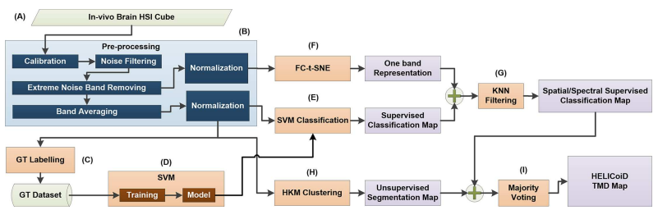
Proposed work in literature:

Slide 7
Implemented Work:
In-vivo Brain HSI Data base
Calibration
Extreme band removal
Decimation
Brightness Normalization
Brightness Normalization
Noise Filtering
Noise Filtering
Normalization
Normalization
One band Representation
Unsupervised Clustering
Supervised Classification
KNN Filtering
Majority Voting

Slide 8
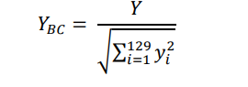
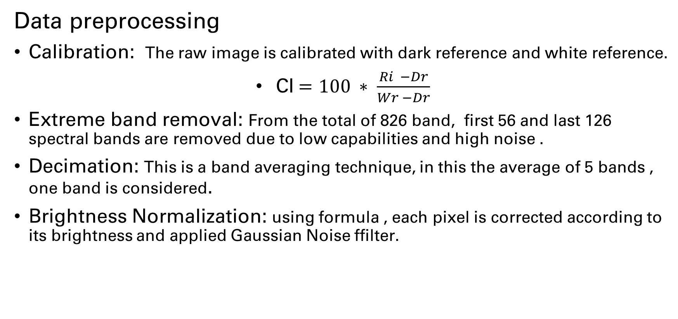
Methodology:
Data preprocessing
Calibration: The raw image is calibrated with dark reference and white reference.
CI$=100 ∗ \frac{Ri −Dr}{Wr −Dr}$
Extreme band removal: From the total of 826 band, first 56 and last 126 spectral bands are removed due to low capabilities and high noise .
Decimation: This is a band averaging technique, in this the average of 5 bands , one band is considered.
Brightness Normalization: using formula , each pixel is corrected according to its brightness and applied Gaussian Noise ffilter.

Slide 9
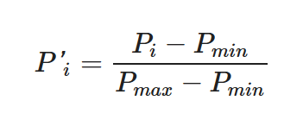
Data Normalization: The spectral signature of each pixel is normalized between [0,1] with the formula
One band representation: Features of all bands combined and represented in one band . To do dimensionality reduction using PCA and T-SNE.
Supervised Classification: Pre-processed image is classified into classes based on the ground truth map using Random forest for better accuracy.
Unsupervised Clustering: same pre-processed image is clustered based on the intensities of pixels using K-means clustering.
KNN filtering: Filters the PCA or t-SNE image using Supervised classification map to ensure spatial continuity.
Majority Voting: It is applied to clustered image using KNN filtered map assigning each pixel to the most common label among its neighbouring pixels.
Additionally performed the endmembers and abundance maps extraction to check the similarity with the hybrid classification model.

Slide 10
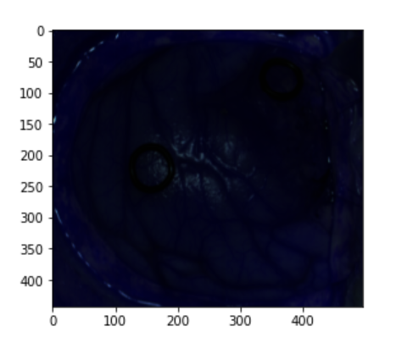
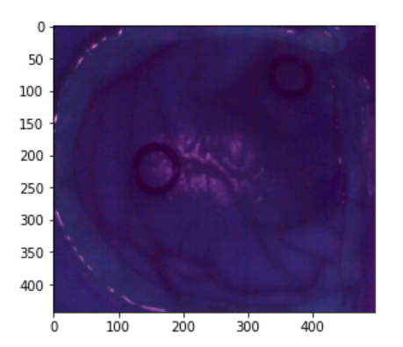
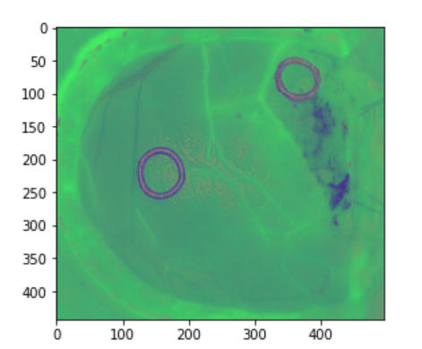
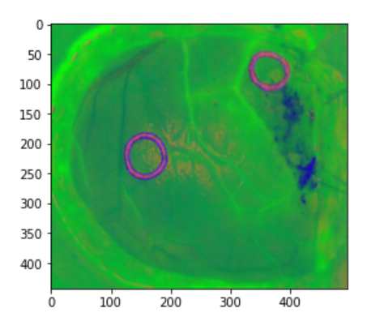
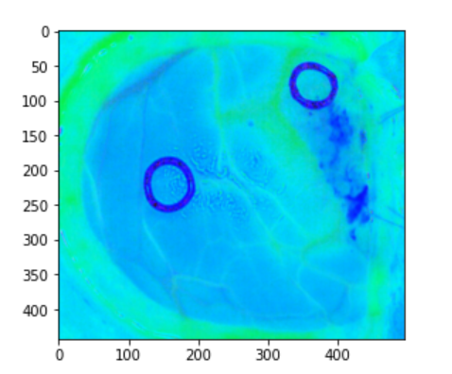
Results : Preprocessed images
Raw image
Calibrated image
Brightness Normalized
Noise filtered image
Final Normalized image

Slide 11
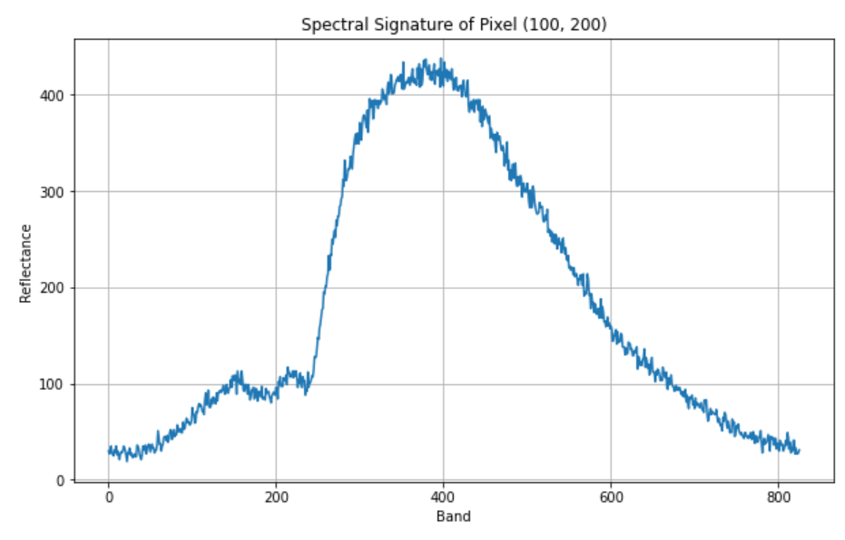
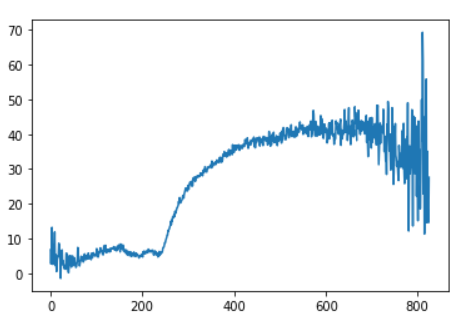
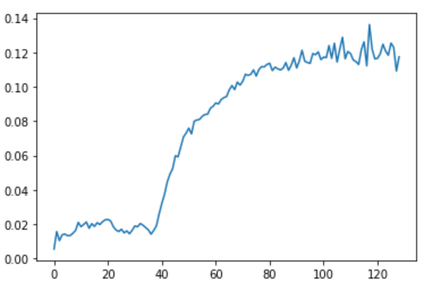
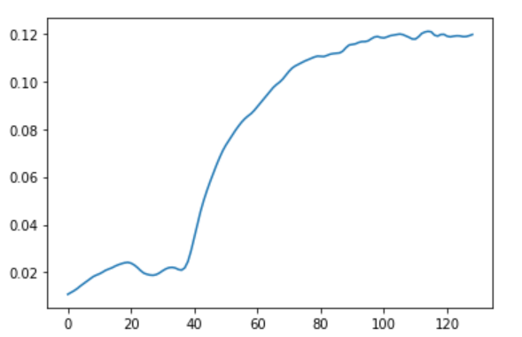
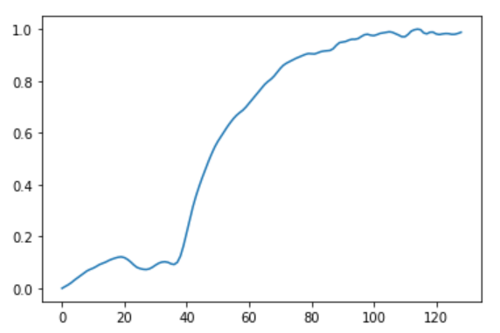
Spectral signatures of preprocessed: (At (100,200) pixel)
Raw image
Calibrated image
Brightness normalized
Noise filtered image
Data normalized

Slide 12
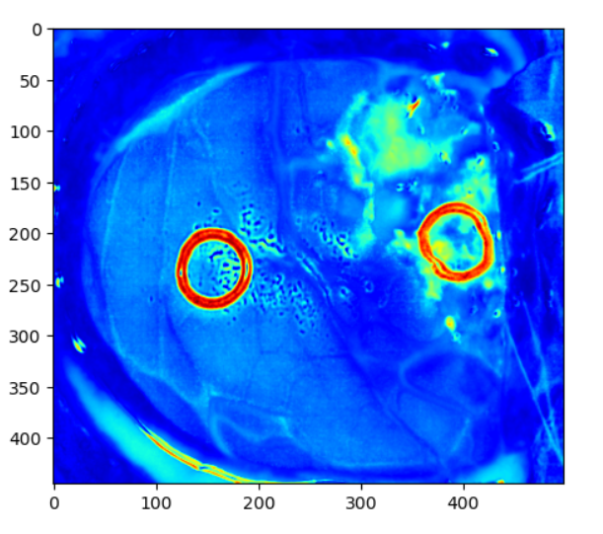
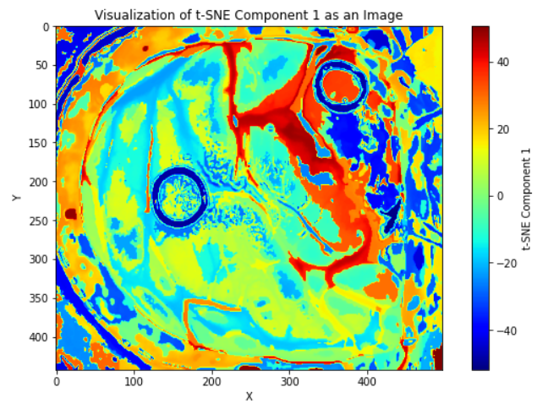
One band represented images:
T-SNE image
PCA image

Slide 13
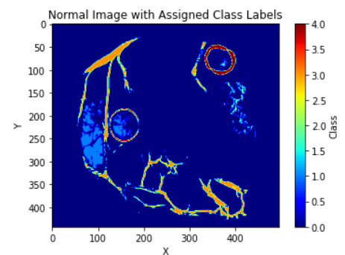
Supervised Classification Map:
For Supervised classification of Preprocessed image , we have used Random Forest classifier which gives us accuracy of 0.999998 or 99.998% when compared to SVM classifier. With the SVM classifier the accuracy of 0.956 or 95.666% has recorded . So we proceeded to perform Random forest classification

Slide 14
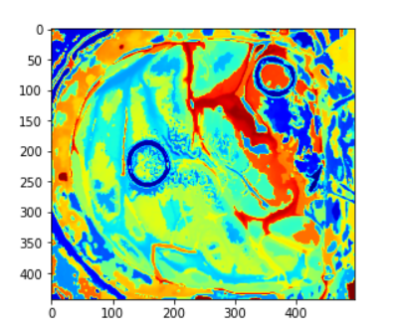
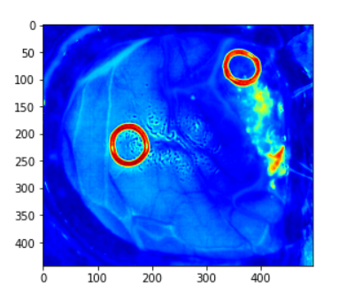
KNN filtering maps:
For t-SNE image
For PCA image

Slide 15
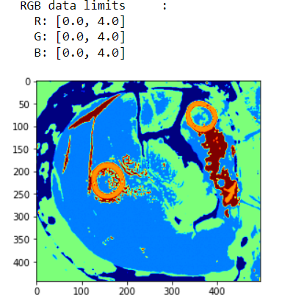
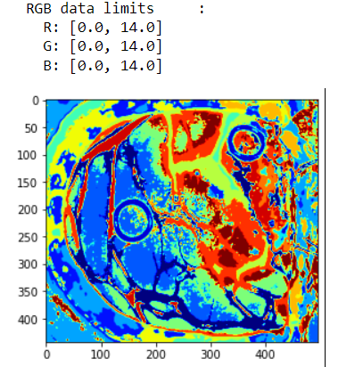
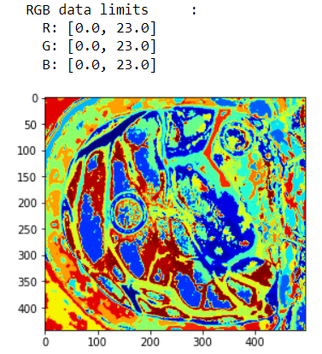
Unsupervised Segmentation: (K-means)
For 5 clusters
For 15 clusters
For 24 clusters

Slide 16
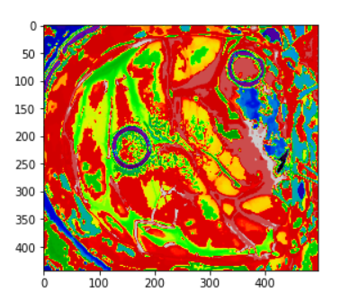
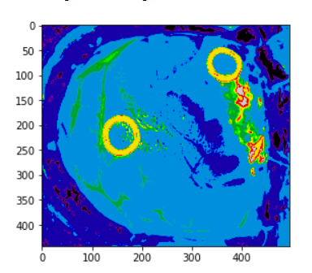
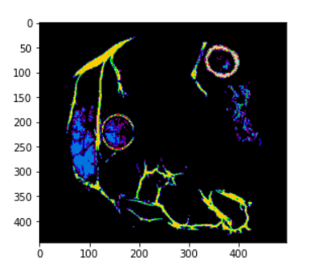
Majority Voting Maps:
When t-SNE image used for KNN filtering
When PCA image is used for KNN filtering
Ground truth map for Reference

Slide 17
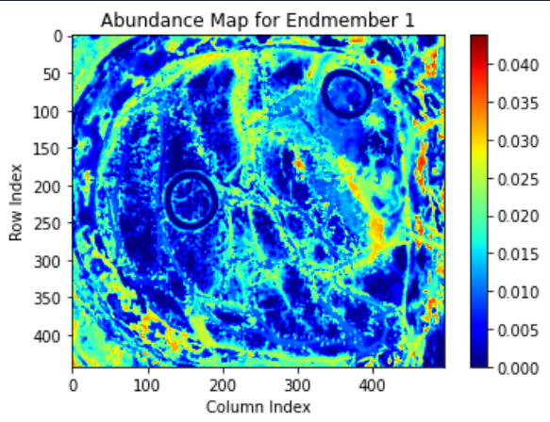
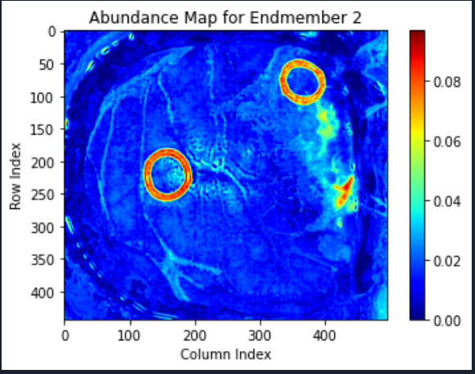
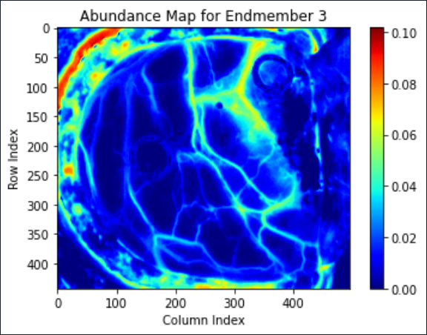
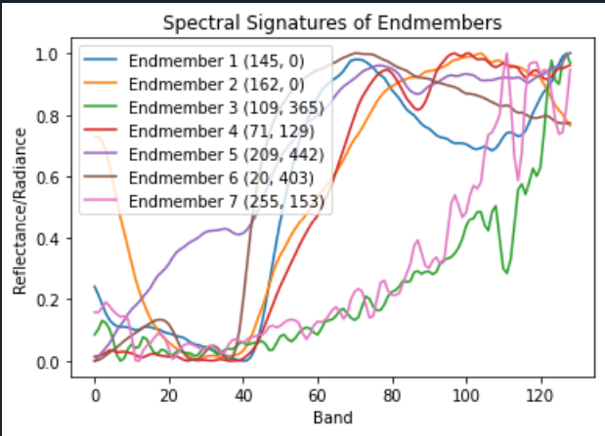
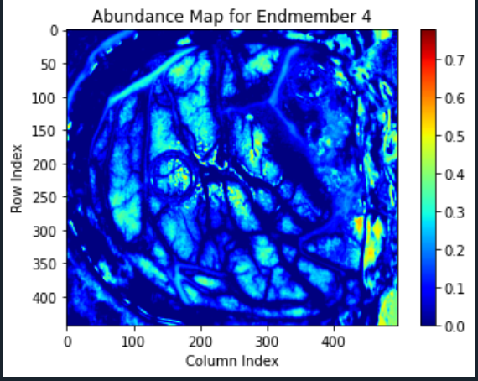
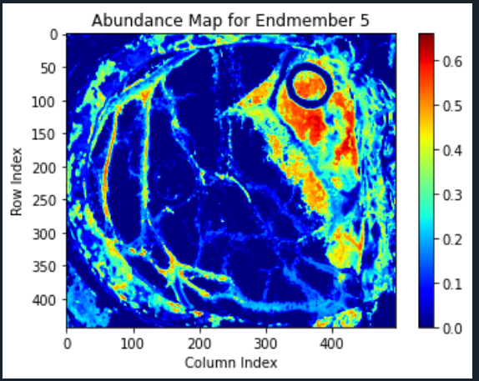
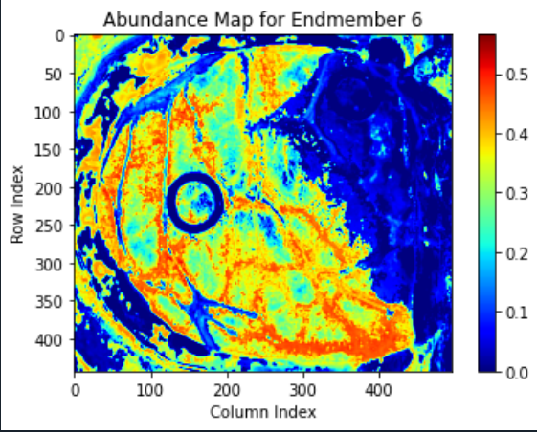
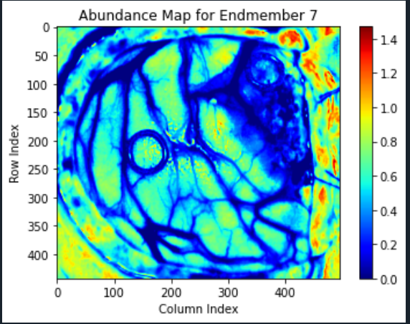
Additional Results (End members and abundance Maps):
These endmembers and abundance maps for 7 endmembers

Slide 18
Conclusions:
The result of hybrid model classification is TMD (Three Maximum Density)maps which represent the segmentation of tumor tissue class and normal tissue class. Any how these results cannot be compared with the ground truth maps because in ground truth there are manually assigned. But we got the SSIM(Structural Similarity Index Metric) of 0.99 and MSE of 2.45 . So we can say there will be similarity between the output and ground truth map.
Further research has to be done to perform segmentation efficiently.

Slide 19


